Slide 1
CS4031 Compiler Construction Lecture 2-Chapter 3
Faryal Saud
Lecturer, Department of Computer Science
FAST NUCES CFD

Slide 2
Outlines
The role of lexical analyzer
Input Buffering
Specification of tokens
Recognition of tokens
Lexical Analyzer Generator Lex
Finite Automata
Design lexical Analyzer generator
Optimization of DFA based pattern matches

Slide 3
Lexical Analysis
The main task of the lexical analyzer is to read the input characters of the source program, group them into lexemes, and produce an output of a sequence of tokens for each lexeme in the source program.
It takes the modified source code from language preprocessors that are written in the form of sentences. The lexical analyzer breaks these syntaxes into a series of tokens, by removing any whitespaces or comments in the source code.

Slide 4
Lexeme
A lexeme is a sequence of source code that matches one of the predefined patterns and thereby forms a valid token.
Example:
int c = 5;
Lexeme | Tokens
Int | Keyword
C | Identifier
= | Assignment operator
5 | constant
; | symbol

Slide 5
Pattern
A pattern is a description of the form that the lexemes of a token may take. In the case of a keyword as a token, the pattern is just the sequence of characters that form the keyword.
For identifiers and some other tokens, the pattern is a more complex structure that is matched by many strings

Slide 6
Tokens
A token is a pair consisting of a token name and an optional attribute value.
Partition input string into substring, and classify according to the rule
Identifier x, y11, maxsize
Keywords if else while for
Integers 2 1000
Floats 2.0 1000.0
Symbols + ) ( > <
Strings “enter x” “error”

Slide 7
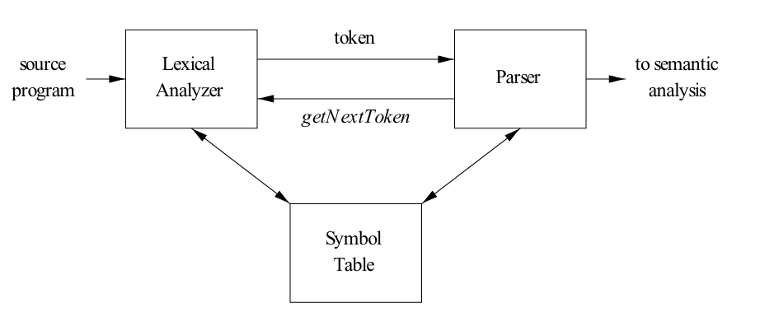
Interaction between lexical Analyzer and parser

Slide 8
Symbol Table
A symbol table is one of the most important data structures within a compiler, where all the identifiers used in a program are stored along with their type, scope, and memory locations.

Slide 9
Example of symbol table
int semester;
char x[ ] = “compiler construction”
Name | Type | Size | Dimension | Line Of Declaration | Line Of Usage | Address
semester | int | 2 | 0 | - | - | -
x | char | 20 | 1 | - | - | -

Slide 10
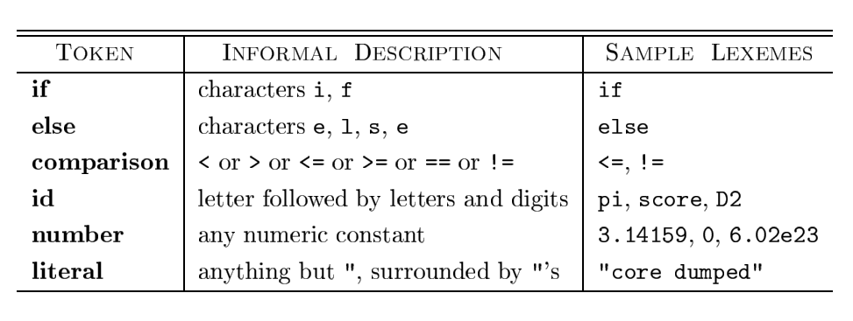
To see how these concepts are used in practice, in the C statement
printf("Total = %d\n", score);
both printf and score are lexemes matching the pattern for token id, and "Total = %d\n" is a lexeme matching literal.

Slide 11
Ad-hoc Lexer
Ad-Hoc means using the concept of already known languages.
Hand-written code to generate tokens.
Partition the input string by reading left-to-right.
Recognize one token at a time.
Ad-hoc Lexer require Look-a-head
LOOK A HEAD
It used to check where one token end and next token begins.

Slide 12
Example: simply we create a class which have ability to make the token of input stream.
class Lexer
{
Inputstream s;
char next; //look ahead
Lexer(Inputstream _s)
{
s = _s; next = s.read();
}

Slide 13
Example: simply we create a class which have ability to make the token of input stream.
class Lexer
{
Inputstream s;
//as we know inputstream is function in C++ which is used for I/O.
char next; //look ahead
Lexer(Inputstream _s)
{
s = _s; next = s.read();
}

Slide 14
Example: simply we create a class which have ability to make the token of input stream.
class Lexer
{
Inputstream s;
char next; //look ahead
Lexer(Inputstream _s) //constructer of the class
{
s = _s; //s is used to store the input stream next = s.read();
}

Slide 15
How to perform the Tokenization via Program.
Here we declare the method of class
Token nextToken() {
if( idChar(next) )
return readId();
if( number(next) )
return readNumber();
if( next == ‘”’ )
return readString();
...
...

Slide 16
How to perform the Tokenization via Program.
Here we declare the method of class
Token nextToken() {
if( idChar(next) )
return readId(); // if the letter is identifier mean follow the rule of identifier
if( number(next) )
return readNumber();
if( next == ‘”’ )
return readString();
...
...

Slide 17
How to Make the token of Identifier
Token readId() {
string id = “”;
while(true){
char c = input.read();
if(idChar(c) == false)
return new Token(TID,id);
id = id + string(c);
}
}

Slide 18
Ad-Hoc Lexer using C++
Identifier x, y11, maxsize
Keywords if else while for
Integers 2 1000
Floats 2.0 1000.0
Symbols + ) ( > <
Strings “enter x” “error”

Slide 19
Firstly create the function for keywords
int isKeyword(char buffer[]) {
char keywords[32][10] = {
"auto","break","case","char","const","continue","default","do","double","else","enum","extern","float","for","goto", "if","int","long","register","return","short","signed", "sizeof","static","struct","switch","typedef","union","unsigned","void","volatile","while" };
int i, flag = 0;
for (i = 0; i < 32; ++i) {
if (strcmp(keywords[i], buffer) == 0) {
flag = 1;
break;
}}
return flag;
}

Slide 20
To check the operator
//decalration of operator
operators[] = "+-*/%=";
for (i = 0; i < 6; ++i) {
if (ch == operators[i])
cout << ch << " is operator\n";
}

Slide 21
Check identifiers
if (isalnum(ch)) {
buffer[j++] = ch;
}
else if ((ch == ' ' || ch == '\n') && (j != 0)) {
buffer[j] = '\0';
j = 0;
if (isKeyword(buffer) == 1)
cout << buffer << " is keyword\n";
else
cout << buffer << " is indentifier\n";
}
}

Slide 22
How to describe the tokens?
Regular languages are the most popular for specifying the tokens.
Simple and useful theory
Easy to understand
Efficient implementations

Slide 23
Languages
Let S be a set of characters. S is called the alphabet.
A language over S is set of strings of characters drawn from S.

Slide 24
Notations
Languages are sets of strings (finite sequence of characters)
Need some notation for specifying which sets we want
For lexical analysis we care about regular languages.
Regular languages can be described using regular expressions.

Slide 25
Regular languages
Each regular expression is a notation for a regular language (a set of words).
If A is a regular expression, we write L(A) to refer to language denoted by A.
A regular expression (RE) is defined inductively
a ordinary character from S
ε the empty string

Slide 26
Basics of Regular expression
Functionalities | Purpose
R | S | Either R or S
RS | R followed by S
R* | Concatenation of R zero or more time
R? | Zero or one R
R+ | RR* (one or more R)
(R) | R ( grouping)

Slide 27
Example
Integers
A non-empty string of digits
Digits = 0|1|2|3|4|5|6|7|8|9|10
Integer = digit digit*
Identifiers
String or letter or digits starting with a letter
C identifier
a – z
A – Z
0 - 9

Slide 28
How to use RE?
We need mechanism to determine if an input string w belongs to L(R), the language denoted by regular expression R. Such a mechanism is called acceptor.
input string
w
yes, if w ∈ L
acceptor
no, if w ∉ L
language
L

Slide 29
Requirement
Specification
Regular Expression
Implementation
Finite Automata

Slide 30
Finite Automata
Finite Automaton consists of
An input alphabet (S)
A set of states
A start (initial) state
A set of transitions
A set of accepting (final) states

Slide 31
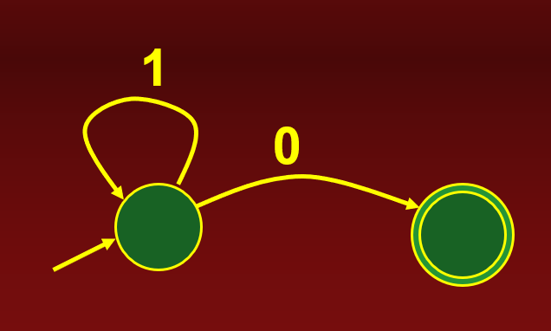
Finite Automata
A finite automaton accepts a string if we can follow transitions labelled with characters in the string from start state to some accepting state.
FA Example: A FA that accepts any number of 1’s followed by a 0.

